Slide 1

Data analysis on IPL Cricket League
Analysis of IPL matches from the year 2008 to 2020 is done using python packages like pandas, matplotlib and seaborn.

Slide 2
Introduction
Have you ever considered the importance of Big Data on Cricket? The game of cricket is no different, as it too contains a wealth of data that can be analyzed for greater insight.
Analyzing all the previous years' data is helpful not only to the players, but also to the team, because it enables everyone to identify and overcome their weaknesses. The data can also be helpful to organizers for understanding their finances.
India is the biggest cricket market, but it is not limited to it. So, people tend to spend a lot of money to see their heroes in action in a live match. It's no secret that watching a game live is vastly different from watching it on television. Through the sale of tickets and broadcasting rights to TV stations, these organizations make their profits.

Slide 3
About cricket
Cricket is an outdoor game that involves a bat, ball, and stumps. There are usually two teams participating in this game, and the team scoring the most runs wins. As a game played within 22 yards of a field, cricket is known as a run-based sport. Additionally, so-called "Umpires" are present to resolve disputes and give fair decisions. Whenever a bat scores more than 100 runs or a ball hits the wicket, it's worth celebrating. There is a great deal of excitement surrounding the game around the globe and it is the national game of England.

Slide 4
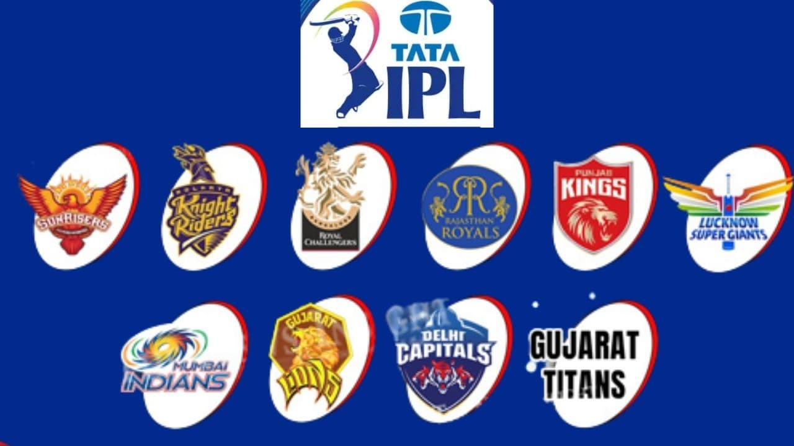
About Indian Premier League (IPL)
Indian Premier League (IPL) is a professional men's Twenty20 cricket league contested by ten teams from ten Indian cities during April and May of every year. It was established by the Board of Control for Cricket in India (BCCI) in 2007.

Slide 5

Problem statement
We have conducted an exploratory data analysis on two different datasets, for the purpose of determining what factors may have an impact on a team's chances of winning. The factors we chose to analyze are as follows: Win rate, number of games played, result of the pre-game coin toss, and the venue. We were also curious to know about additional factors, such as: highest performing players.

Slide 6
data visualization libraries and data sets
This Python notebook uses Python packages such as pandas, matplotlib, and seaborn to analyze IPL matches from 2008 to 2020. The dataset that we use in this notebook are IPL Matches From 2008-2020 and IPL Ball-to-Ball Data From 2008-2020.

Slide 7
exploratory data analysis (EDA) along with their respective visualization

Slide 8
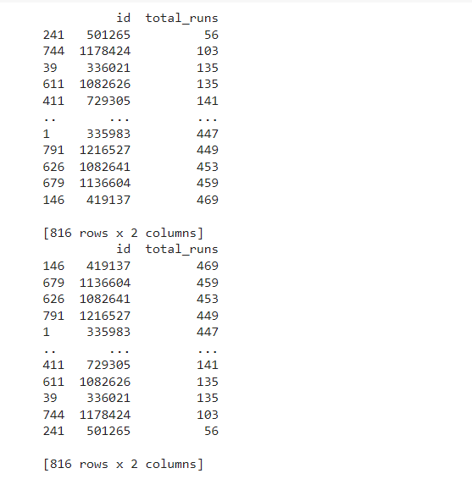
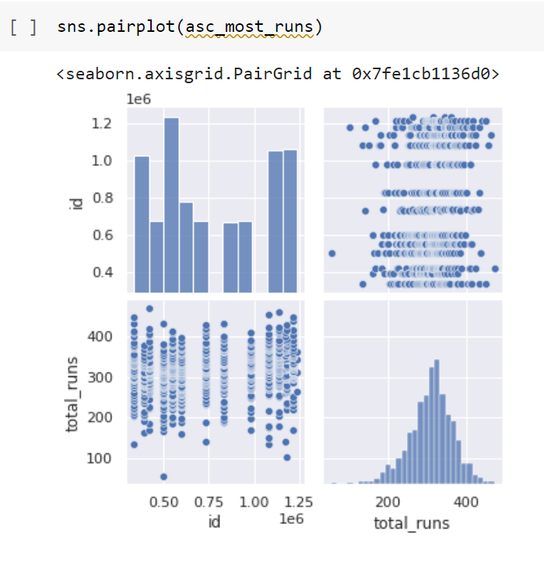
Data visualization for Most Runs Scored
The following shows the player Id and total runs scored by the players
The data on most runs scored is represented as a pair plot in the following Image.

Slide 9
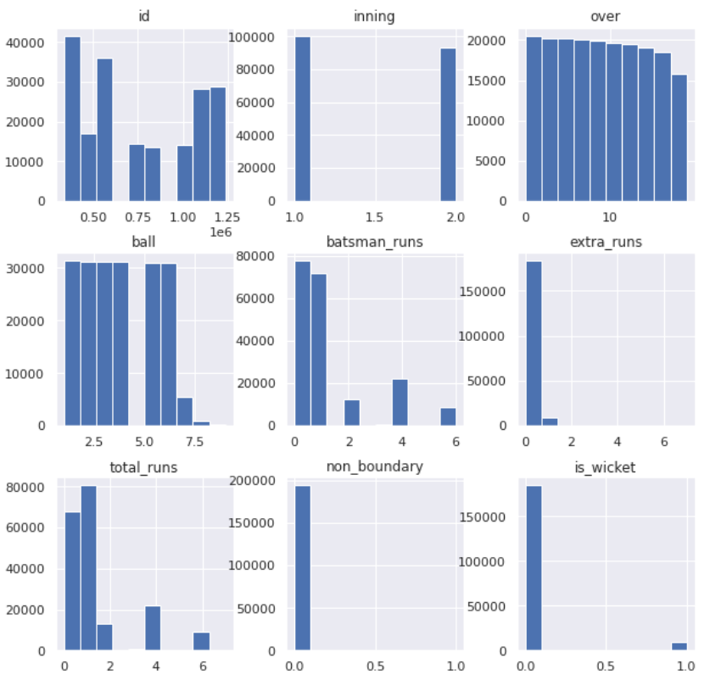
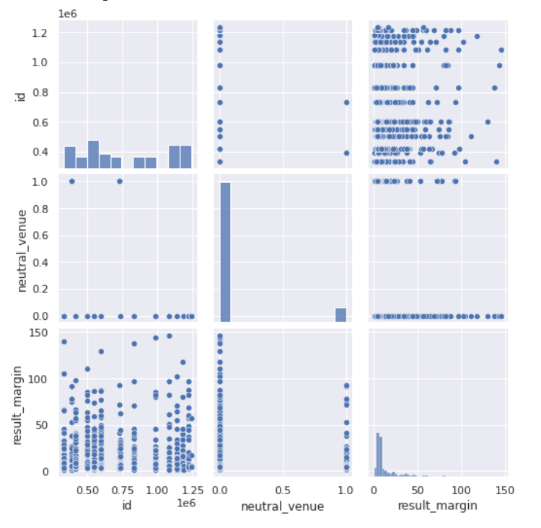
Histogram and Pair Plot for all the attributes in the data set
histogram
Pair plot

Slide 10
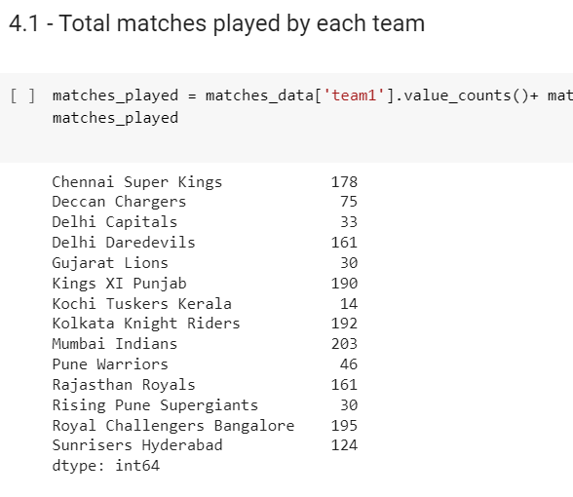
Total matches played by each team over the years
The following picture shows the total matches played by all the team so far from 2008 to 2022 in a tabular form.
The following Image shows the number of matches won by each team over the years in a tabular form.

Slide 11
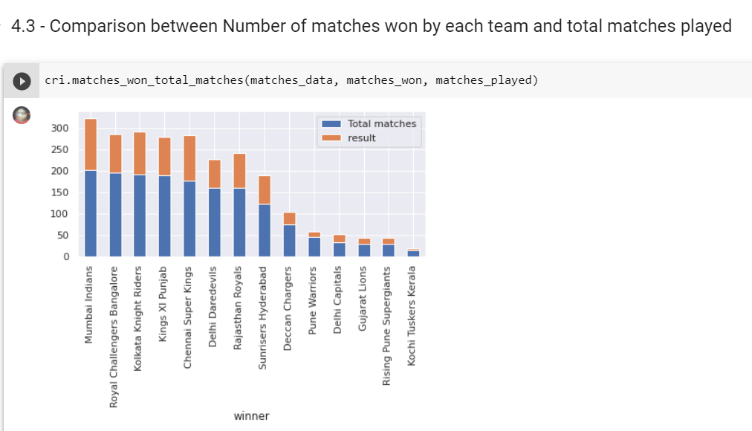
Comparison between Number of matches won by each team and total matches played
The following diagram shows the comparison of the Number of Matches won to the Total Number of Matches played as a bar graph format.

Slide 12
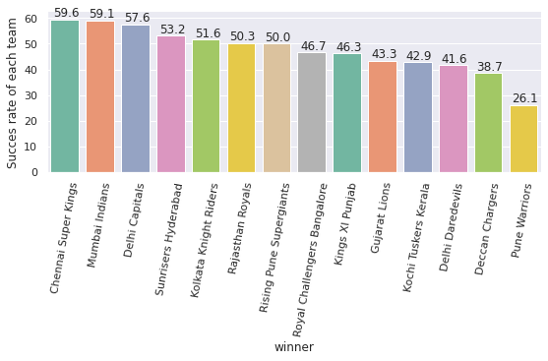
Success Rate of each team
From this graph we can see that Chennai Super Kings have highest winning success rate (59.6%) , followed by Mumbai Indians (59.1%). Without doing a full statistical analysis, it seems clear that the teams that play more games tend to have a higher win percentage.

Slide 13
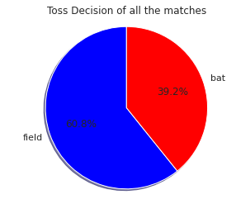
Toss Decision across matches
From the following Image we get to know that 60.8% of the toss winning teams chose Fielding first while the other 39.2% chose Batting first.

Slide 14
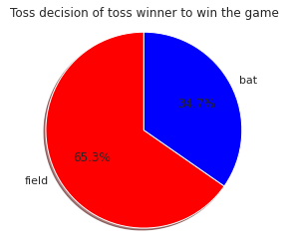
Toss Decision in which Toss winner is the game winner
From the following diagram we get to know that 65.3% of the toss winning teams had decided to field first while 34.7% had decided to Bat first and won the matches.

Slide 15
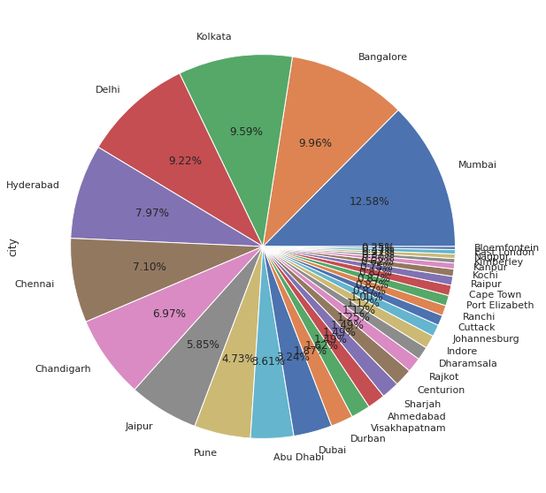
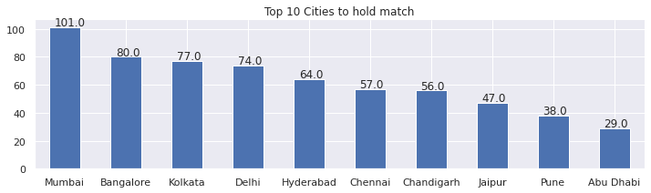
Top 10 Cities to hold match
The following diagram shows the data for the Top 10 Cities to hold match in a bar graph format.
From this Image we get to know that Mumbai had the highest number of matches (101.0) followed by Bangalore (80.0).

Slide 16
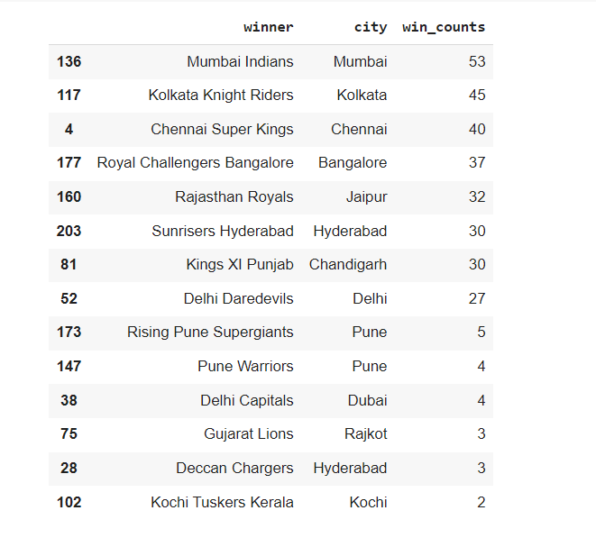
The win count of each team on their home city
Most of the Teams have won the most matches on their home city grounds.

Slide 17
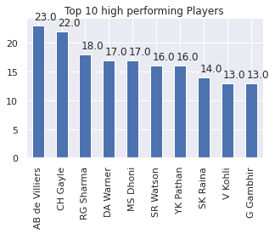
Top 10 high performing Players
AB de Villers has won Player of the match 23 times followed by CH Gayle who had won 22 times.

Slide 18
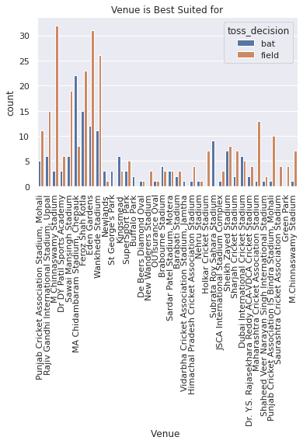
Graph showing Stadium suited for batting or fielding based on previous matches won
From the following graph we know that M Chinnaswamy stadium and Eden Gardens is best Suited for Feilding and MA Chidambaram Stadium ,Chepauk is best suited for Batting.

Slide 19
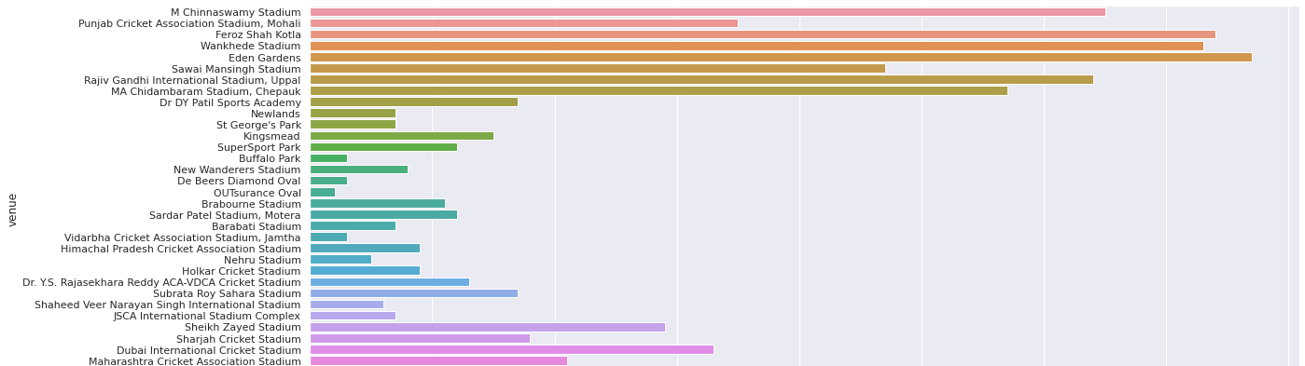
Venue
Eden Gardens is the most used stadium and after that it is the Feroz Shah Stadium.
The least used stadium is OUTsurance Oval Stadium

Slide 20
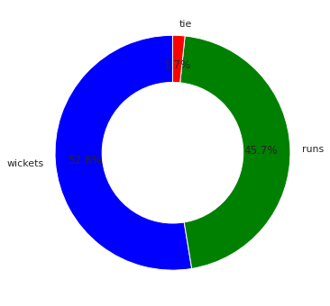
Runs Vs Wickets in A Combined Data frame
Wicket
BAT
The following Image give us the information about Runs Vs Wickets.

Slide 21
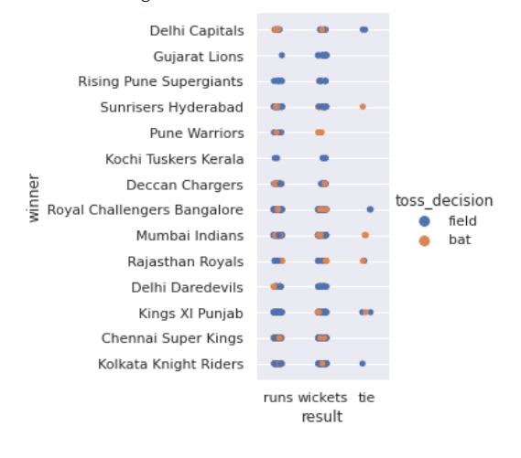
team won both match and toss
The following graph show the information in the form of Cat plot for about all the teams who won both matches and the toss.

Slide 22
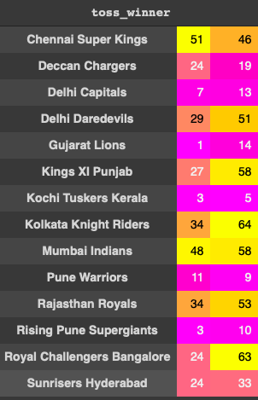
Toss Winner Vs Toss Decision
The teams who won toss also are the one won most of the matches

Slide 23
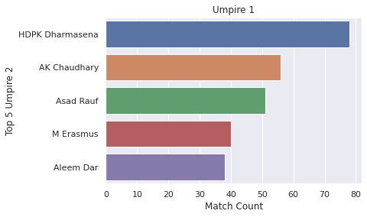
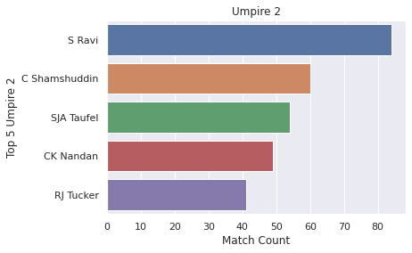
Top 5 Umpires in Field

Slide 24
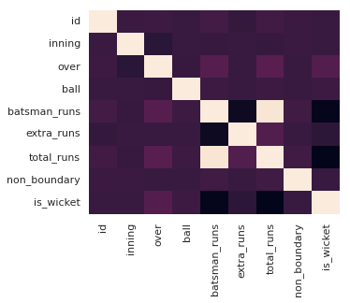
Correlation in Ball-By-Ball database
Correlation is show in the following image for the dataset Ball-by-Ball. Each square shows the correlation between the variables on each axis. Values closer to zero means there is no linear trend between the two variables. The close to 1 the correlation is the more positively correlated they are. Larger the number and darker the color the higher the correlation between the two variables.

Slide 25
Overall Results
Teams that played the most games were more likely to win their future games
Teams that won the coin toss were more likely to win games
Teams that had home field advantage were more likely to win games

Slide 26
Specific Results
The success rate of Rising Pune Supergiant's is good comparatively among the new teams.
Royal Challengers Bangalore and Chennai Super Kings are best defending team.
From the year 2014 most of the teams are opting to field after winning the toss and are also successful in winning matches.
Overall Chennai Super Kings and Mumbai Indians have high success rate.
From the analysis we can see that Chennai Super Kings and Mumbai Indians are more likely to win upcoming IPL seasons.

Slide 27

Conclusion
Taking all these factors into account, we found a likely correlation between number of games played and number of games won. In addition, winning a coin toss at the beginning of each game seems to work on the favor of the team. All this are just a fraction of data analysis performed on this data set there are even more thing we can learn from the past. Hence, we can only Imagine how all this data analysis done on these data sets could be used by the Team management and the Event Organizers to work their shortcomings and work more efficiently.

